Slide 1
IBM Services Platform with Watson Client Use Cases
Jason C. LaScola
Enterprise IT Advisor
GTS Technology Innovation & Automation

Slide 2

Bombardier Engagement
Signed Q2/2017
Client, Challenge and Solution
Impact and Lessons Learned
Client Background and Challenge
Bombardier Inc. is engaged in design, development, manufacturing and marketing activities in transportation and aerospace. Bombardier operates two major divisions, Bombardier Aerospace (BA) in Montreal and Bombardier Transport (BT) in Berlin. Bombardier is seeking to increase the value IT brings to the business while sustainably lowering IT spend. Through improvements in the delivery model for both BA and BT, Bombardier is seeking:
Synergies and shared services between BA and BT divisions
Potential sources of value and cost advantage from third parties.
Client Value and Business Impact
Program and savings “staircase” to deliver USD $504M savings in 5 years from total Bombardier IT budget (across entire program)
Flexibility to grow IT with business fluctuations.
Modernize Business applications and improve user experience
Transformation to a predominantly aaS financial and delivery model over 2-3 years to reduce business risk
Integrate IT organization between BA and BT to one global IT org.
Jason LaScola
EITA Advisor
Enterprise Transformation Solution
Building shared ITaaS hub in Softlayer (LON & DAL) that includes IBM Cloud Broker, ServiceNow, orchestration with Vrealize suite, and Cirba
Create 3 (possibly a 4th in Frankfort) regional Softlayer spokes (Paris, Dallas, Montreal).
Create private cloud for two existing client DC’s, Montreal (Viger BA) and Frankfort (BT). Manage remaining legacy as is.
Provide link to 3rd party clouds (AWS and Azure).
Perform Application Rationalization , Migration, and Modernization across BA and BT to modernize apps, reduce redundant applications and infrastructure , and migrate workloads to Softlayer cloud.
Provide Remote Office as a Service (ROaaS) using converged systems
Perform this transformation to ITaaS in 3 phases over 2 years.
IBM Value and Business Impact
$1B CAD TCV signing ($700M US), AMS for App rationalization and migration, Infrastructure Services (compute, storage, network),
First deal in Canada to leverage ITaaS on large scale. Can leverage for future deals if successful, both for GTSaaS and ITaaS references
GBS opportunity to expand cloud migration and portfolio transformation
Lessons Learned (what worked what didn’t)
(+) EITA Advisor brought ITaaS leadership to deal team early in the process. EITA should be involved prior to RFI if possible.
(+) Successful service delivery with IBM at BA on large global projects increased client trust that we can deliver
(+) Accelerating clients existing Cloud strategy and enhanced it vs full rip and replace
(-) GBS and GTS working separately for most of the engagement with lack of single leader across both
(-) Short time to turn around solution after DD. Client felt we did not adequately leverage the data they provided.
(-) Significant number of IBM staff often caused a lack of cohesive work plan
(+) Team members crossed roles where they had unique skills to get work done
Reused Offerings and Assets
Enterprise IT Advisor and ISPW Assets
Client Reference Architecture – Lloyds Bank
GTS and GBS cloud workload analysis and migration
A huge opportunity to show IBM’s current strengths in infrastructures management with a clear potential to expand into a full EITaaS model by demonstrating our Cognitive and Automation capabilities
Notes:
Quick background on Bombardier Engagement
Key components of the solution
– Building a shared ITaaS Hub in Softlayer for cloud orchestration to client private environments in Montreal and Germany
Adding IBM Broker services for the public cloud to AWS and Azure
Including key compoents of the IBM Services Platform with Watson including
Dynamic Automation
PASIR

Slide 3
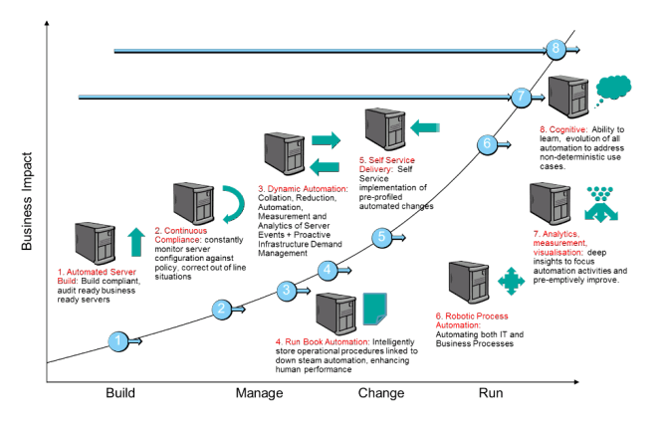
Understanding the scope & architecture guidelines
IBM Services Platform Content
Automated Server Build
Dynamic Automation
CDI / SDI
PASIR
Continuous Compliance
Risk-Based Patching
IBM scope

Slide 4
IBM Services Platform with Watson
Evolution of Automation initiatives and ITaaS to a next generation platform which continuously preempts problems and optimizes every aspect of the client’s environment
01 IBM’s Data Lake
02 Cognitive Delivery Insights
+ Cognitive Micro Services
+ Knowledge Modules
06 Client-Centric Dashboards
Operations Data from all Client Environments
ITaaS Environment
05 Cognitive Solution Designer
Workloads
Services Capabilities from IBM and Other Providers
Brokerage
Tech Leaders
IBM Services
3rd Party Services
04 Cognitive Services Optimizer
Orchestration
Data Sharing Partnerships
Operations
Architects
Software-Defined Hybrid Cloud Infrastructure
03 Cognitive Services Manager
Client Environment’s Data
Traditional IT
Private Cloud
Public Cloud
Administrators
Felix Scope
Automated Server Build
Continuous Compliance
Self Service Delivery
Run Book Automation
Cognitive Dynamic Automation
Robotic Process Automation
Aspirational Scope (uncommitted)

Slide 5
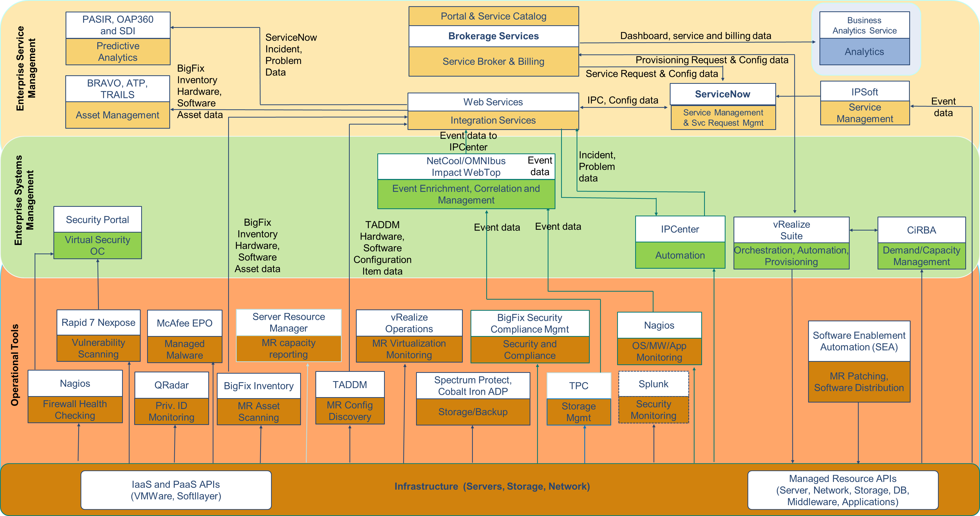
Bombardier Tools Integration

Slide 6
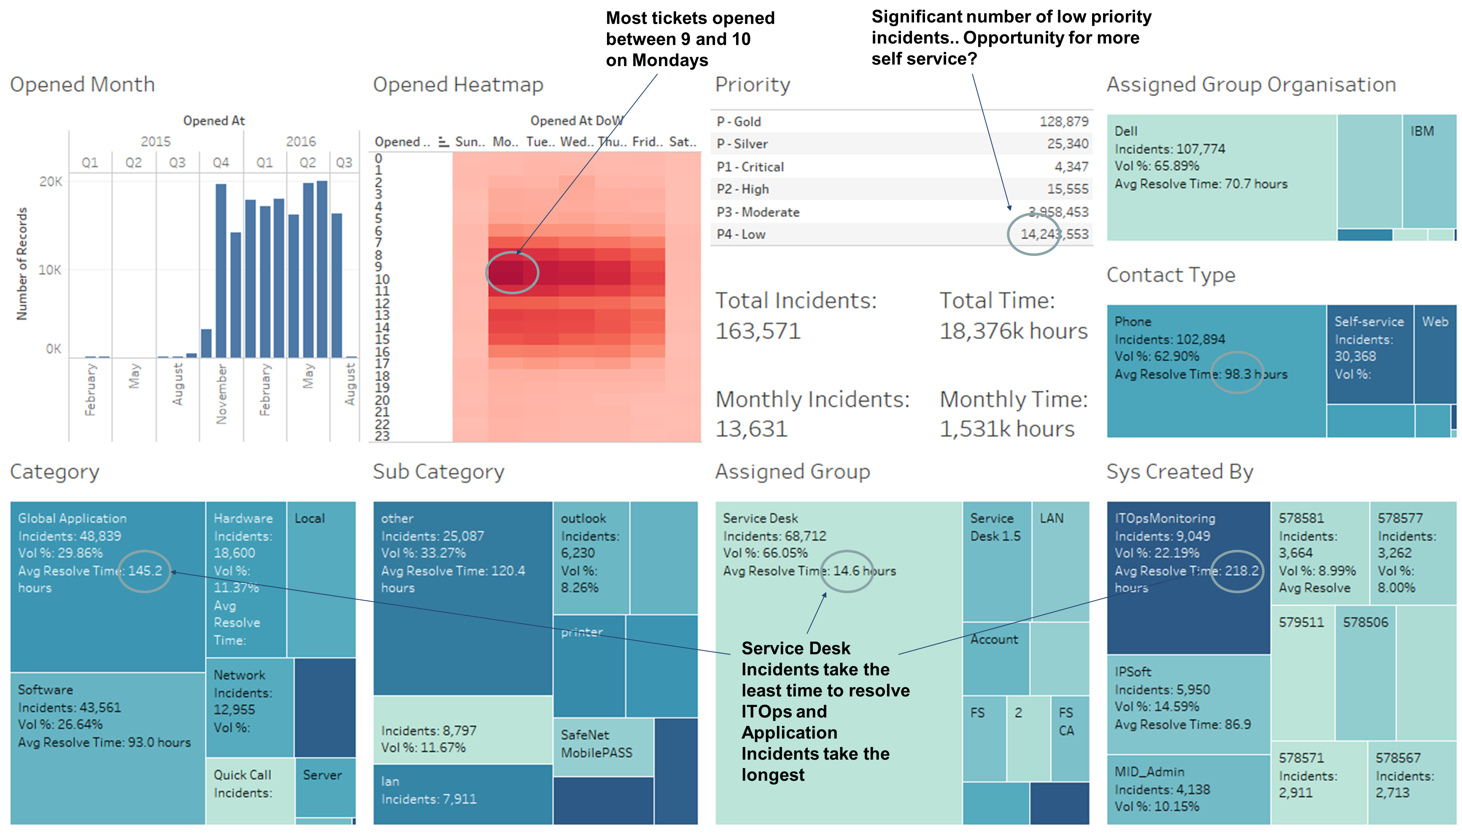
Bombardier Ticket Analytics

Slide 7
Project Yellowjacket (Meijer) Engagement
Signed Q3/2017
Client, Challenge and Solution
Impact and Lessons Learned
Client Background and Challenge
Meijer is a large store and grocery chain mostly in the Midwest US. They have over 300 stores and operate in 6 states. They generate around $8B in revenue per year and are privately owned and operated. Current IT is all in house with AMS and SAP services provided by CapGemini.
Meijer is looking to accelerate to their IT transformation
Increase speed and flexibility
Improve service quality and lower costs
Reduce risk through higher resiliency
Client Value and Business Impact
IBM will save Meijer 35% over their existing base case
~23% reduction in labor based on Dynamic Automation
Jason LaScola
EITA Advisor
IBM Value and Business Impact
New logo client contract signed Q3 for $188M
New IBM Services Platform Customer
Significant future new business potential as they transform
Enterprise IT CloudFirst Transformation Solution
Migrates the mainframe to zCloud in POK and RTP (DR),
Cloudifies their existing 985 data center, and eventually allows them to close down another 982 data center.
Implement an integrated ITaaS Framework and IBM Services Platform
Brings in out of region DR in RTP,
Take over asset ownership upon refresh
Leveraging latest Storage as a Service offerings
Rebadging 100% of IT resources
New Scope Added from Previous Iteration
Hardware and Services SW
Disaster Recovery
Bluemix Scope increate
Signings: | $188M | Savings: | 35%
Lessons Learned (what worked what didn’t)
(+) Significant Client facing time since no TPA process to interfere
(+) Enhancing clients CloudFirst strategy
(+) Client has a positive view of IBM and we have a long existing relationship in HW and SW
(+) IBM ISPW, automation and innovation story resonates
(+) Engagement IT Analytics message and solution
(-) Deal team not always on same page
Reused Offerings and Assets:
IBM Services Platform Assets
Hybrid Cloud services assets
ITaaS Assets from Bombardier
Cloud Workload Assessment, IT Optimization Assessment
Storage ILM study, Backup / Recovery Redesign
Journeymap tailored from Sikorsky
Engagement Analytics Dashboards
Storage as a Service
Potential IBM Growth Areas
Service Desk and Service Management
More use of BlueMix
Replace Teradata with IBM Solution
A huge opportunity to show IBM’s current strengths in infrastructures management with a clear potential to expand into a full EITaaS model by demonstrating our Cognitive and Automation capabilities

Slide 8
Understanding the scope & architecture guidelines
IBM Services Platform Content
Automated Server Build
Dynamic Automation
CDI / SDI
PASIR
WESA
Continuous Compliance
Risk-Based Patching
IBM scope

Slide 9
IBM Services Platform with Watson
Evolution of Automation initiatives and ITaaS to a next generation platform which continuously preempts problems and optimizes every aspect of the client’s environment
01 IBM’s Data Lake
02 Cognitive Delivery Insights
+ Cognitive Micro Services
+ Knowledge Modules
06 Client-Centric Dashboards
Operations Data from all Client Environments
ITaaS Environment
05 Cognitive Solution Designer
Workloads
Services Capabilities from IBM and Other Providers
Brokerage
Tech Leaders
IBM Services
3rd Party Services
04 Cognitive Services Optimizer
Orchestration
Data Sharing Partnerships
Operations
Architects
Software-Defined Hybrid Cloud Infrastructure
03 Cognitive Services Manager
Client Environment’s Data
Traditional IT
Private Cloud
Public Cloud
Administrators
Automated Server Build
Continuous Compliance
Self Service Delivery
Run Book Automation
Cognitive Dynamic Automation
Robotic Process Automation
Yellowjacket Scope
Aspirational Scope (uncommitted)

Slide 10
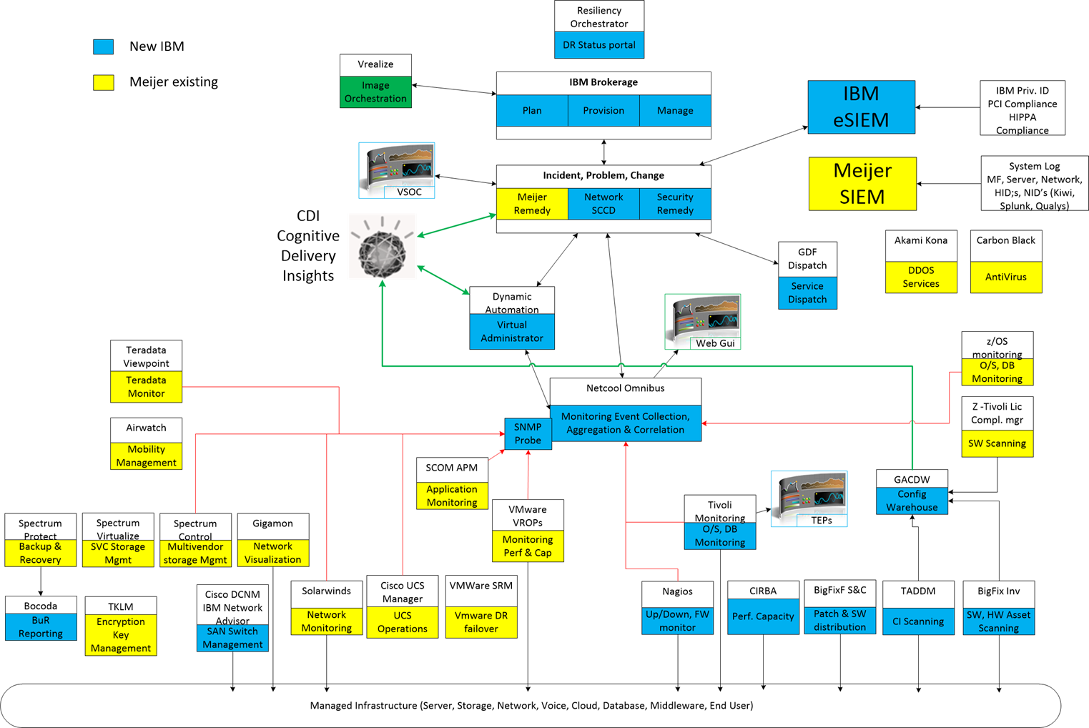
Meijer Tools Integration Overview

Slide 11


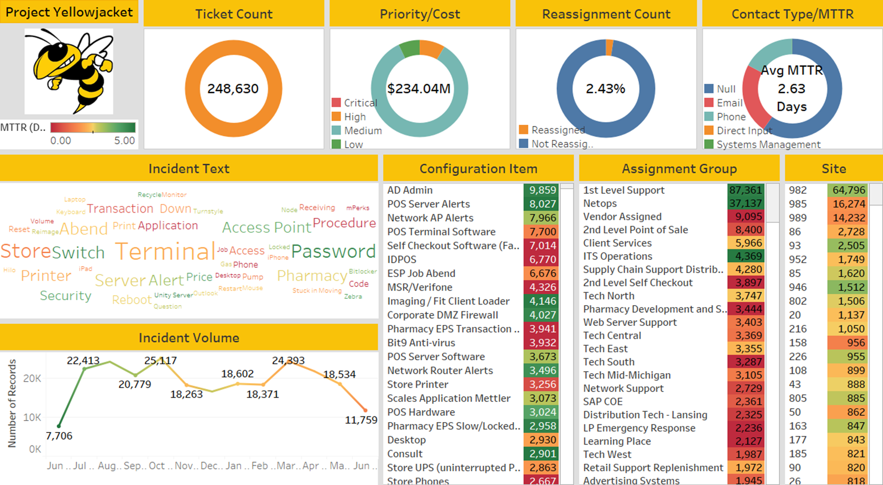

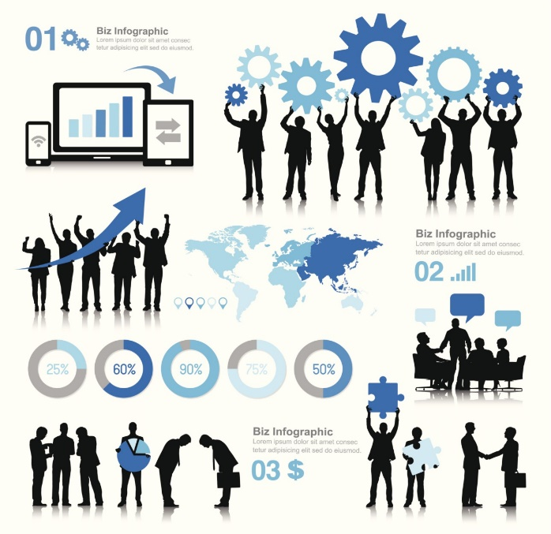
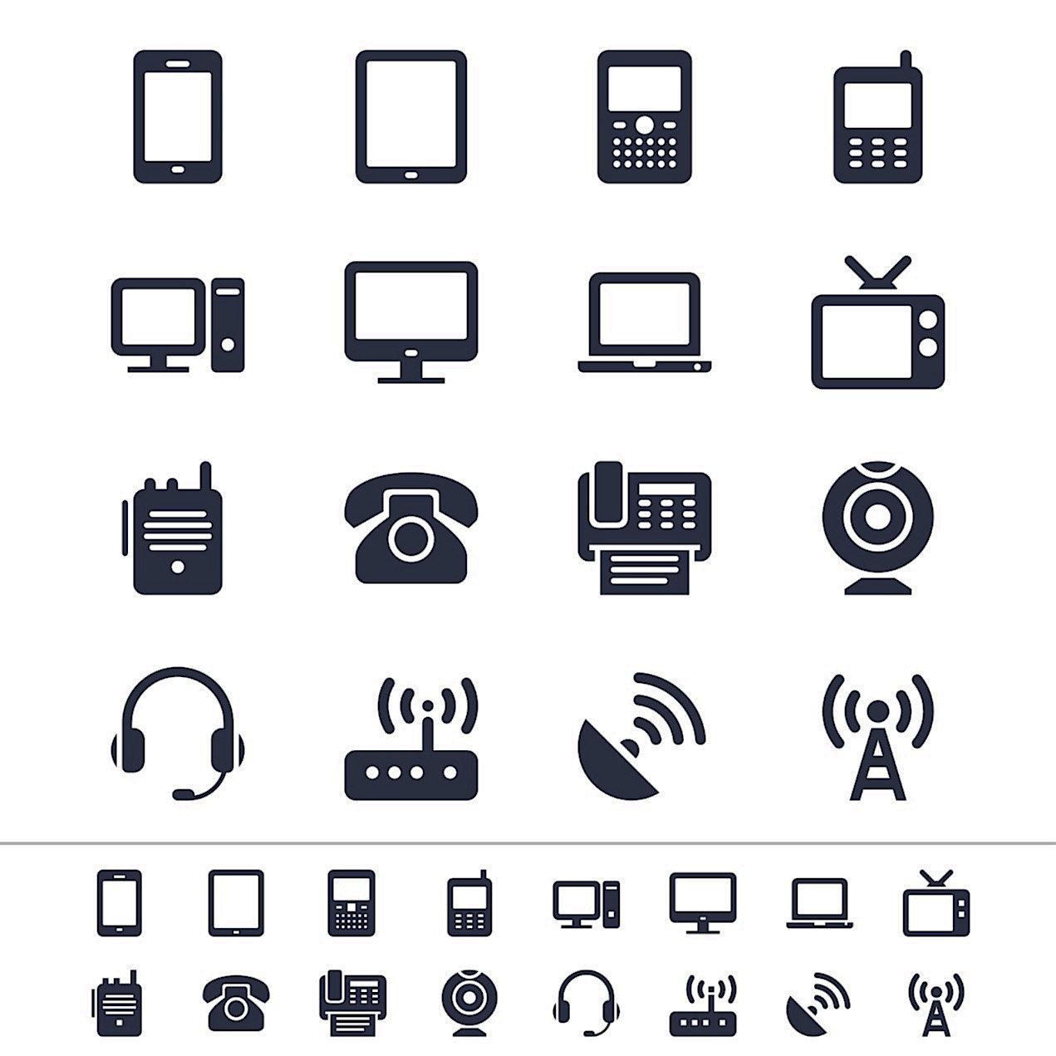


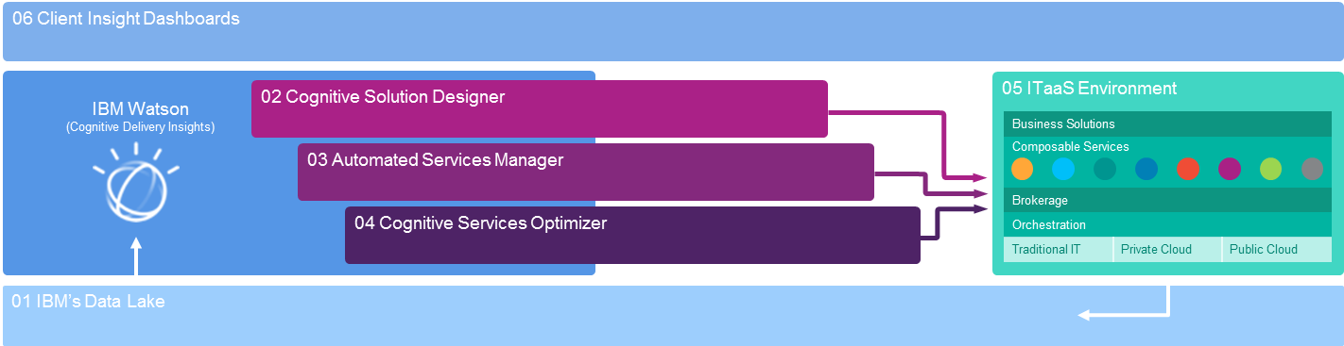
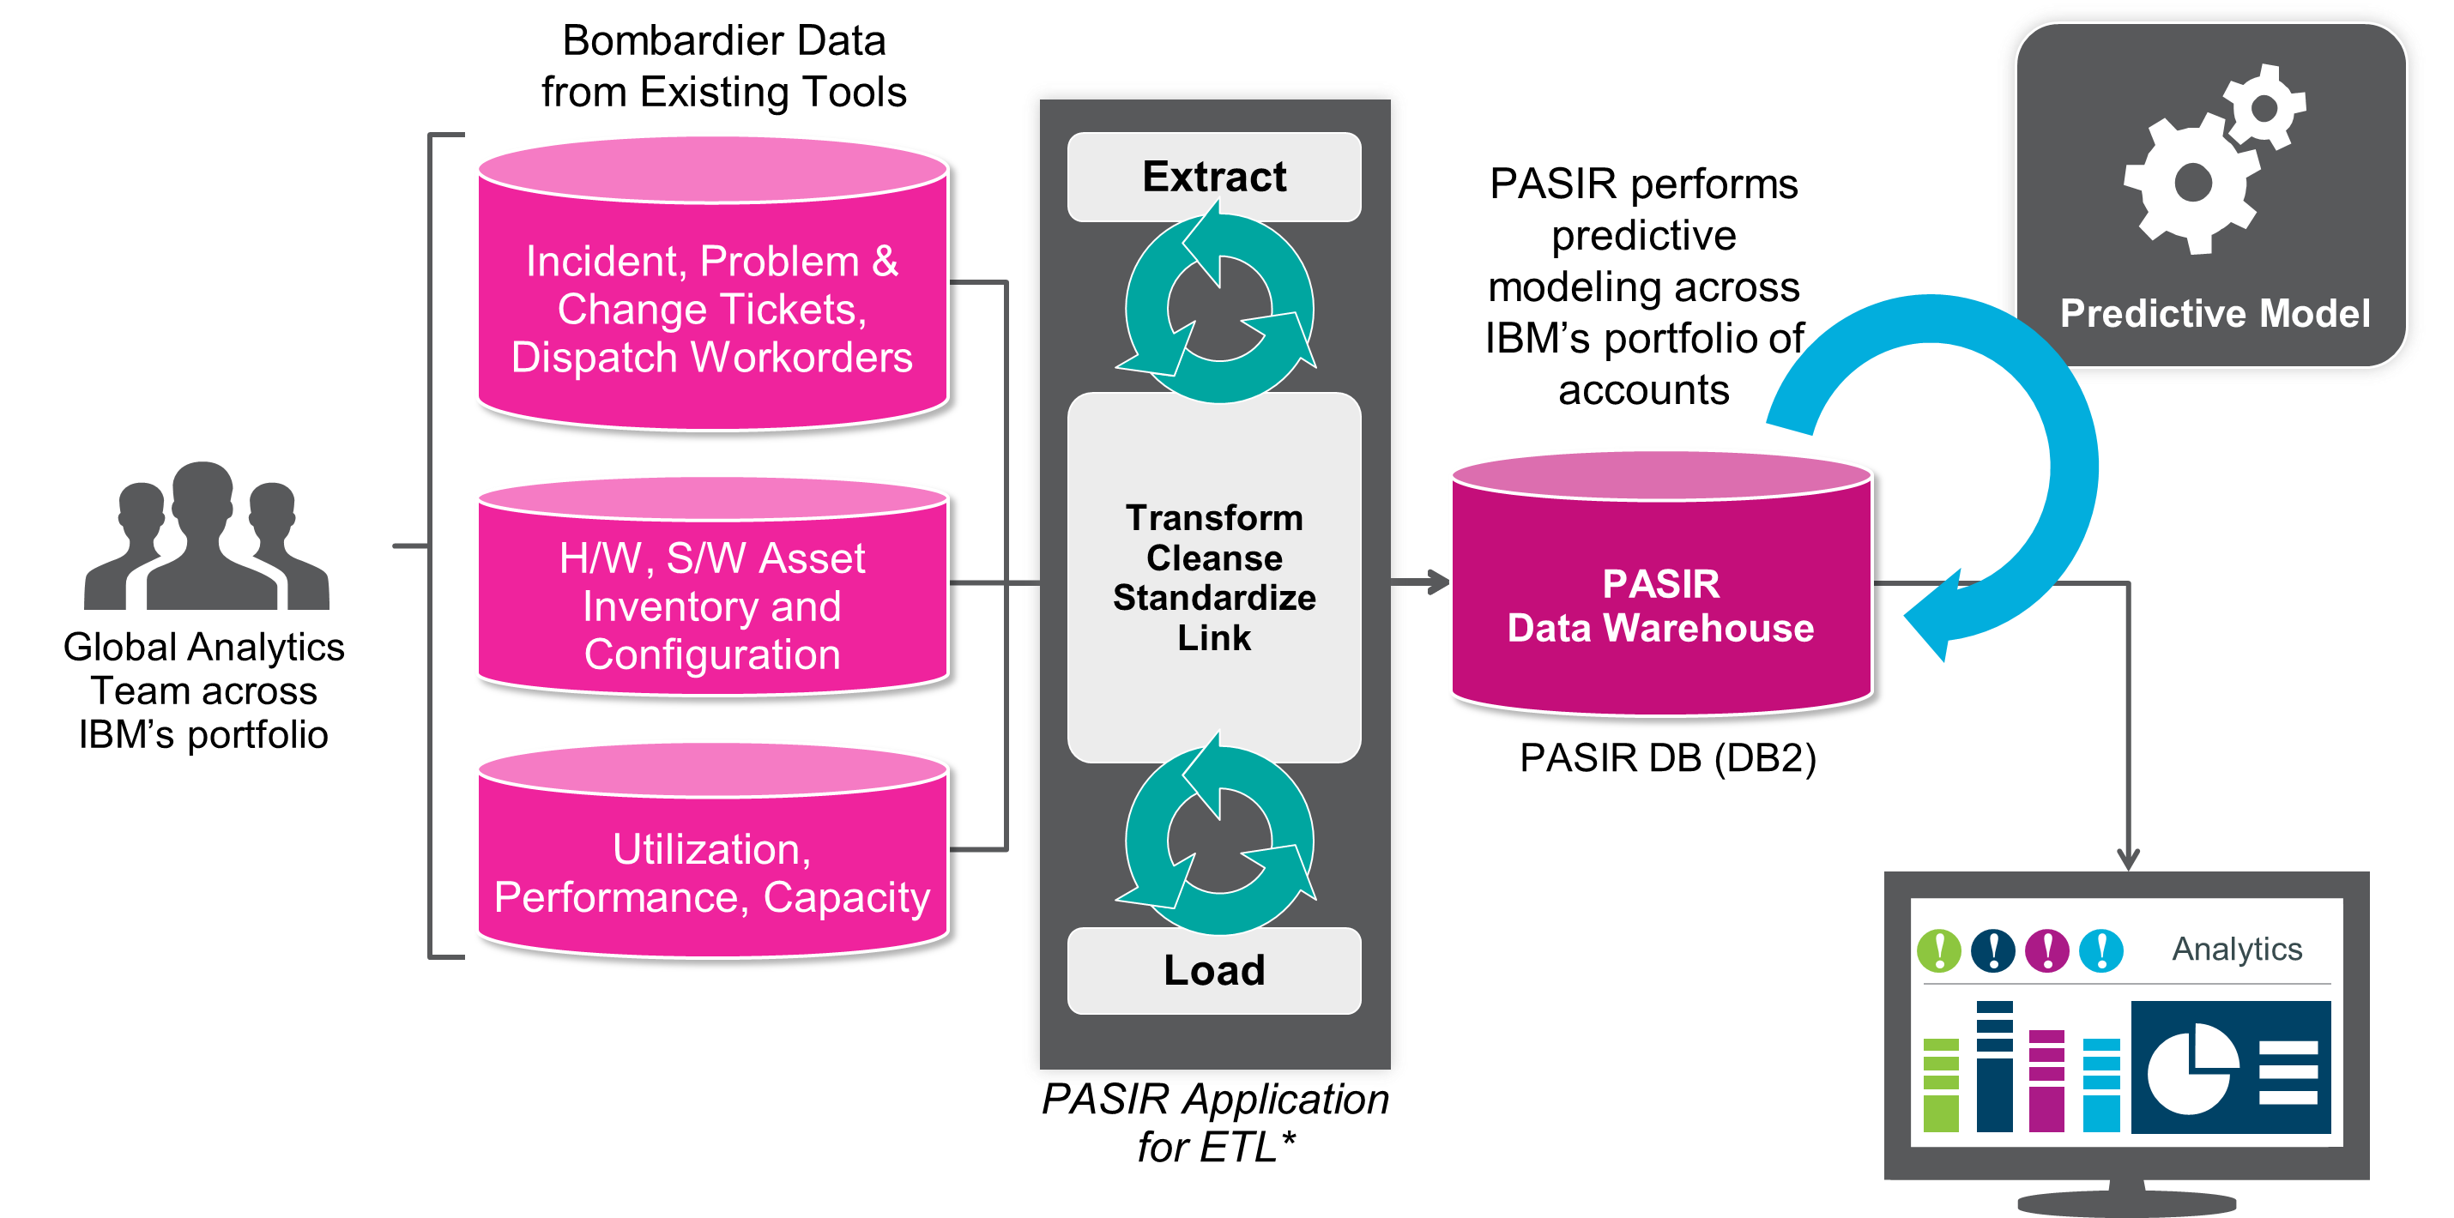

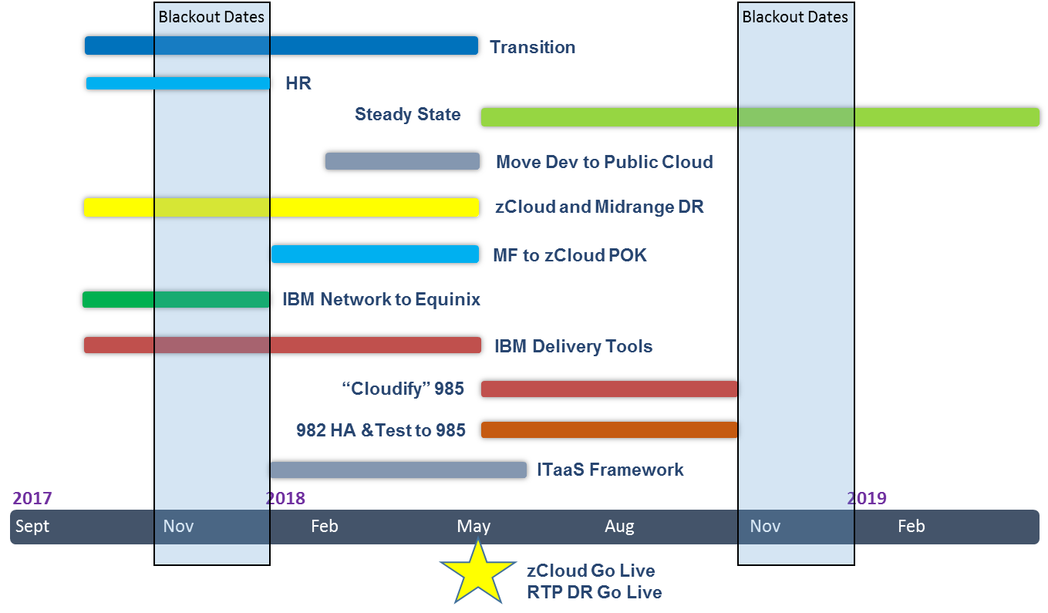
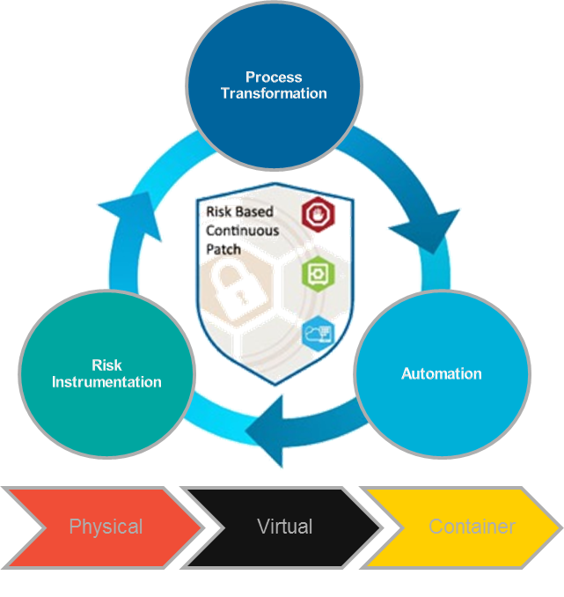


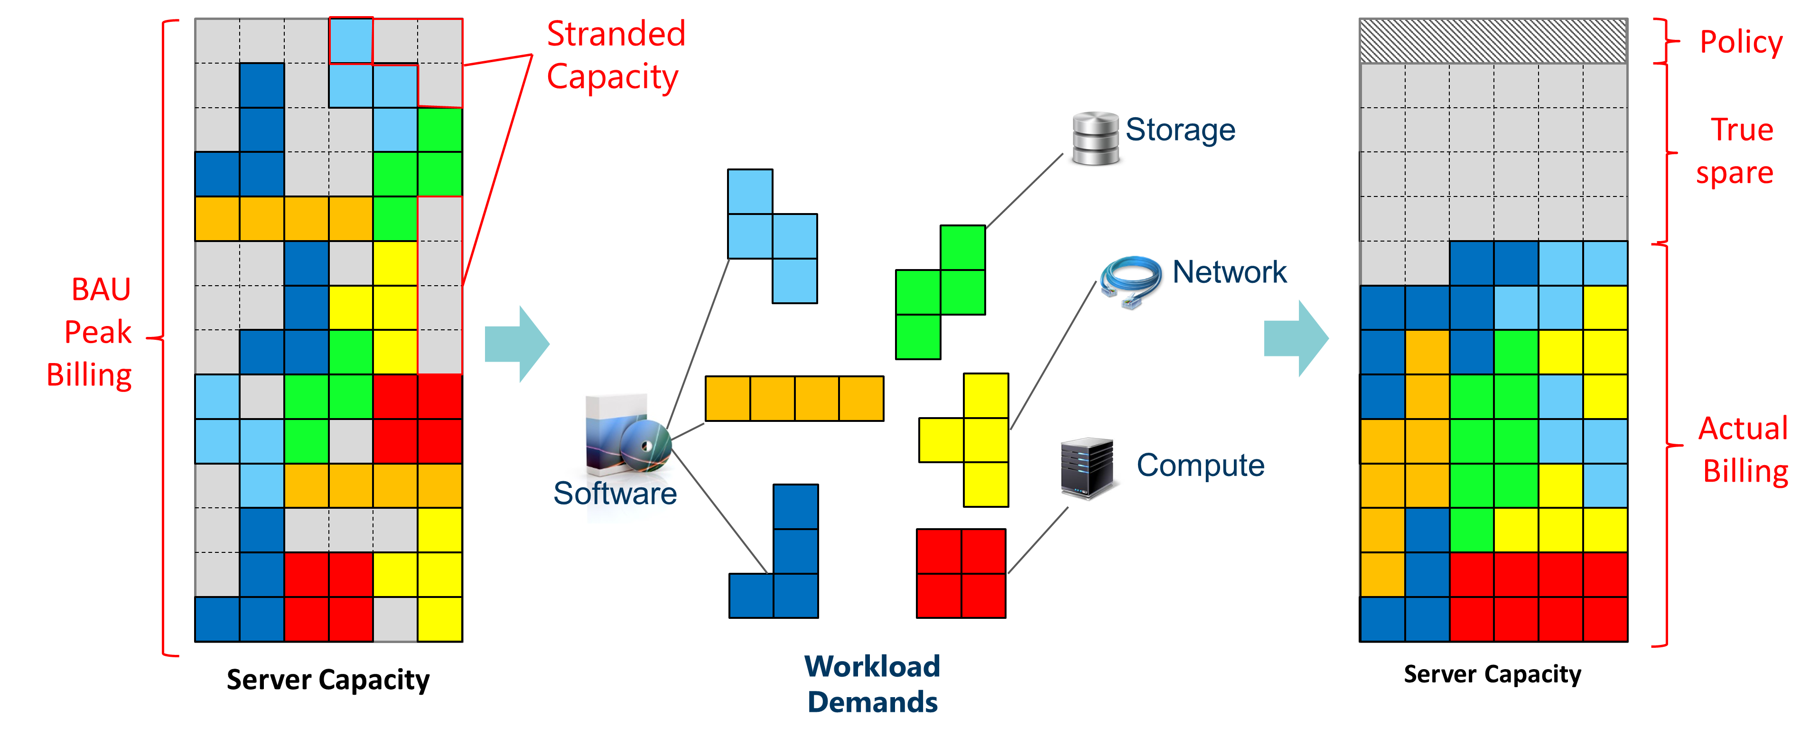
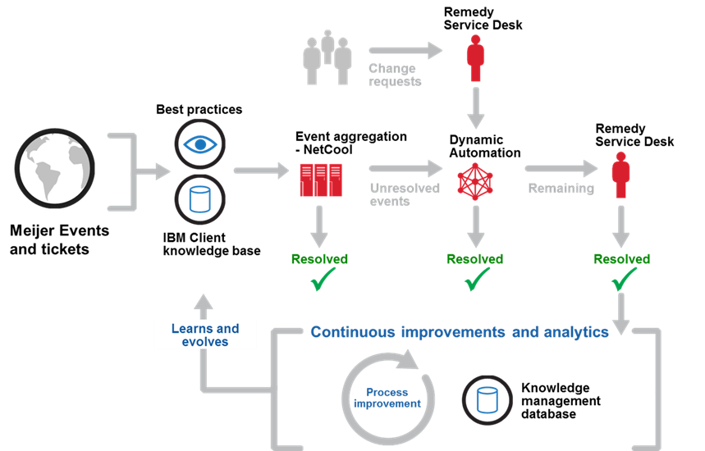
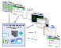



Today
Transform to Future Operating Model
Continue Transformation
Future
Execute a “Cloud-First” Strategy to effectively position the new IT environment to take full advantage of current and future technology and services, driving favorable business outcomes.
Meijer 982
Meijer 985
Leverage Meijer’s investment in 985 for production and test midrange workloads while introducing an IBM out-of-region Disaster Recovery capability
Move assets from 982 to 985 and cluster by tier
Migrate Mainframe to IBM zCloud
Create out-of-region DR in IBM Raleigh, NC for workloads
Complement Meijer tooling with IBM
Application Rationalization Execution
As applications are rationalized, move them to the appropriate cloud platform using ITaaS framework
Align business service levels to application and infrastructure tiers
Apply transformation and “CloudFirst” strategy migrating appropriate production workloads to cloud
Support Scaled Agile Framework (SAFe) through Dev/Ops enabled infrastructure
High average MTTR (2.6 days) for incidents – limited automation
Infrastructure features a Private Cloud for Meijer environment orchestrated with VMware VRealize orchestration and Densify capacity planning, enabling dynamic capacity adjustments through automated monitoring and provisioning of resources. This will enable a consumption-based model and positions for effective management of hybrid cloud environments as Meijer considers future cloud technologies.
Meijer 985
Production
Meijer’s IT environment is positioned to take advantage of current and future Cloud technology to drive favorable business outcomes well into the future.
IBM Poughkeepsie (zCloud)
Asynchronous Replication
IBM
Raleigh (DR)
Speed of IT and Scalability: ITaaS is the future operating model that will improve the speed, flexibility, and capability of IT to address the digital needs of Meijer customers.
Disaster Recovery
Out-of-region solution addressing the needed RTO and RPOs dictated by Meijer tiering strategy
ITaaS Hybrid Cloud Optimized with…
IBM Cloud Broker
IBM Services
3rd Party Services
IBM Services Platform with Watson
Limited use of cloud with integrated legacy environment
Orchestration & Automation
Security
Integrated security framework across IT legacy and cloud managed environments
Resiliency: Complement Meijer’s security team, improving the security posture, while mitigating risk via an out-of-region DR solution.
Traditional IT
Private Cloud
Public Cloud
Infrastructure environment architected to 100% HA vs tiered to business priority
… IBM Services Platform with Watson
Transformation Initiatives
Implementation of IBMs Cloud Brokerage solution for the distribution of workloads based on cloud provider profiles and cost provided via a service catalog
Leverage both hybrid cloud and advanced cognitive automation for delivery model to drive efficiencies and added business value
Generate Savings by lowering cost of ownership through introduction of cognitive analytics and advanced automation into IT operations through IBM Services Platform for Watson (ISPW).
PASIR
Risk-based Patching
Cognitive
Delivery Insights
Business risk mitigated in the event of a disaster by implementation of tiered Resilient Disaster Recovery design
Densify
Dynamic Automation
Robotic Process Automation
No out-of-region Disaster Recovery infrastructure that contributes to higher business risk
Pattern Enablement: IBM to provide execution of patterns and blueprints for agile and dev/ops to support SAFe Framework
Lower Total Cost of Ownership offering new investment opportunities to further Meijer’s digital strategy
Bluemix and IBM zCloud
IBM Cloud for public cloud Dev environment
IBM zCloud for existing mainframe
Storage as a Service
Storage as a Service – consumption base, with IBM technology
© 2017 IBM Corporation

Slide 12
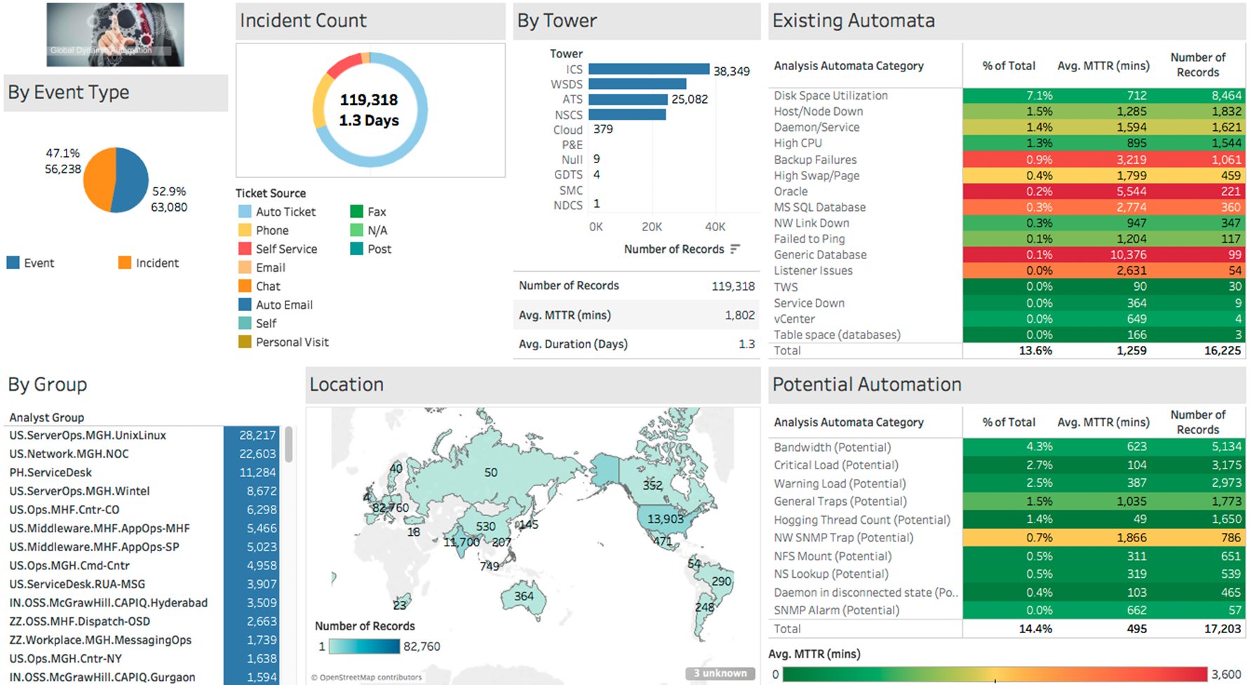

Slide 13
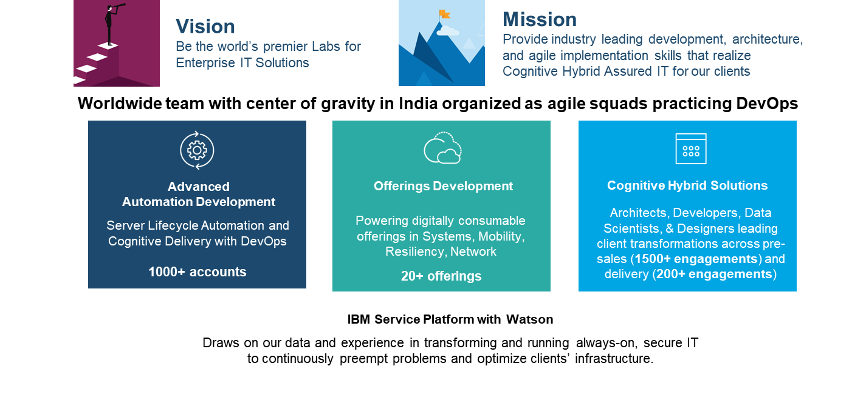
IBM Global Technology Services Labs

Slide 14
Summary and Closing Points
IBM Services Platform is key to client success if we can show real client data such as Dynamic Automation and Ticket Analysis
We should demonstrate the platform in the most ideal situation and leverage GTS Labs where appropriate.
The message must focus on the full automation lifecycle of the IBM Services Platform across process, people, and technology of the IT enterprise operations
We must show how the platform will continue to evolve and the client will benefit from continual automation improvements in the Platform.

Slide 15
Additional Resources – Client Delivery Contacts
Role | Scope | Contact
Bombardier PE | Global | John Hoo – johnhoo@ca.ibm.com
Bombardier Chief Architect | Global | Charlotte Wang – cwang@ca.ibm.com
Bombardier Engagement Architect | Global | Jason LaScola – jlascola@us.ibm.com
Meijer Engagement Architect | US | Jason LaScola – jlascola@us.ibm.com
Meijer Technical Solution Manager | US | Johan Kristoffersen – jkrist@us.ibm.com

Slide 16
Additional Resources – Supporting Materials
Bombardier ITaaS Technical Solution: http://ibmurl.hursley.ibm.com/O7CW
Bombardier Solution Overview: http://ibmurl.hursley.ibm.com/O58H
Bombardier Use Case: http://ibmurl.hursley.ibm.com/O7D1
Meijer Editable Journey Map: http://ibmurl.hursley.ibm.com/O7CV
GTS Engagement Analytics Community: http://ibmurl.hursley.ibm.com/O6Y9
IBM Services Platform with Watson Wiki: http://ibmurl.hursley.ibm.com/O99S

Slide 17

Thank you!
For more information, please visit:
http://www.ibm.com

